Slide 1



AQI Prediction Using Machine Learning in Indian Cities

Slide 2

CONTENTS
Introduction
Dataset Overview
Model Selection - Visualization of Results Conclusion & Q/A
Problem Statement
Data Preprocessing
Model Evaluation
Challenges & Improvements

Slide 3

Introduction
01

Slide 4

Overview of the Project
The project focuses on predicting the Air Quality Index (AQI) using machine learning techniques specifically tailored for various tailored for various cities across India.
Presented by: kunal ,krishnam,prateek ,prateek dubey,krishna,harshit Course :Introduction to Ai
Institution: KIET Group of institution
Date: [Insert Date] 27 may 2025

Slide 5

02
Problem Statement

Slide 6



Why Predict AQI?
Air Pollution Concern
Air pollution is a growing concern in
in many urban areas in India, leading to leading to various health issues.
Air Quality Index
AQI Prediction
The Air Quality Index (AQI) serves as a standardized measure to assess how polluted the air is in specific locales.
Timely prediction of AQI can greatly assist in public health planning and enable individuals to make informed decisions regarding outdoor activities.

Slide 7

03
Dataset Overview

Slide 8

Dataset Description
Data Source
Source: Kaggle – Air Quality Data in India
Time Frame
Time Period: 2015–2020
1
2
3
Cities Included
Cities: Multiple major Indian Indian cities across the country country
4
Key Features
Key Features Included:
•PM2.5, PM10, NO2, SO2, CO,
O3
•Date, City, AQI

Slide 9
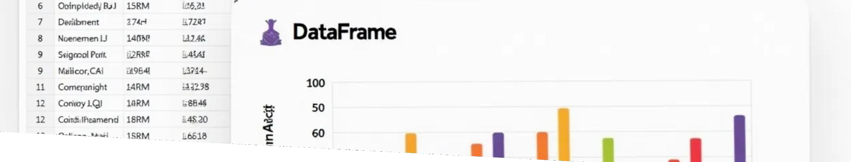
Dataset Description
Data Visualization
Visualization of the dataset can include:
.regression graph representing Actual vs predicted Aqi

Slide 10

04
Data Preprocessing

Slide 11


Data Cleaning & Preparation
Data Integrity
Removed any missing and duplicate entries to ensure data integrity.
Date Conversion
Converted string date formats into datetime objects for easier for easier analysis.
NaN Values Handling
Handled NaN values appropriately using methods such as such as interpolation or mean imputation.
Dataset Normalization
Normalized the datasets using techniques like MinMaxScaler or StandardScaler to prepare data for modeling.
Code Snapshot

Slide 12


Data Cleaning & Preparation
Code Snapshot

Slide 13

05
Understanding Code

Slide 14

Understanding the Data
AQI Trends Analysis
Analyzed the trends of AQI over different time periods to gauge fluctuations.
Correlation Heatmap
Generated a correlation heatmap to to understand relationship strengths strengths among various pollutants. pollutants.
Polluted Cities
Identified the most polluted cities based on available data.

Slide 15
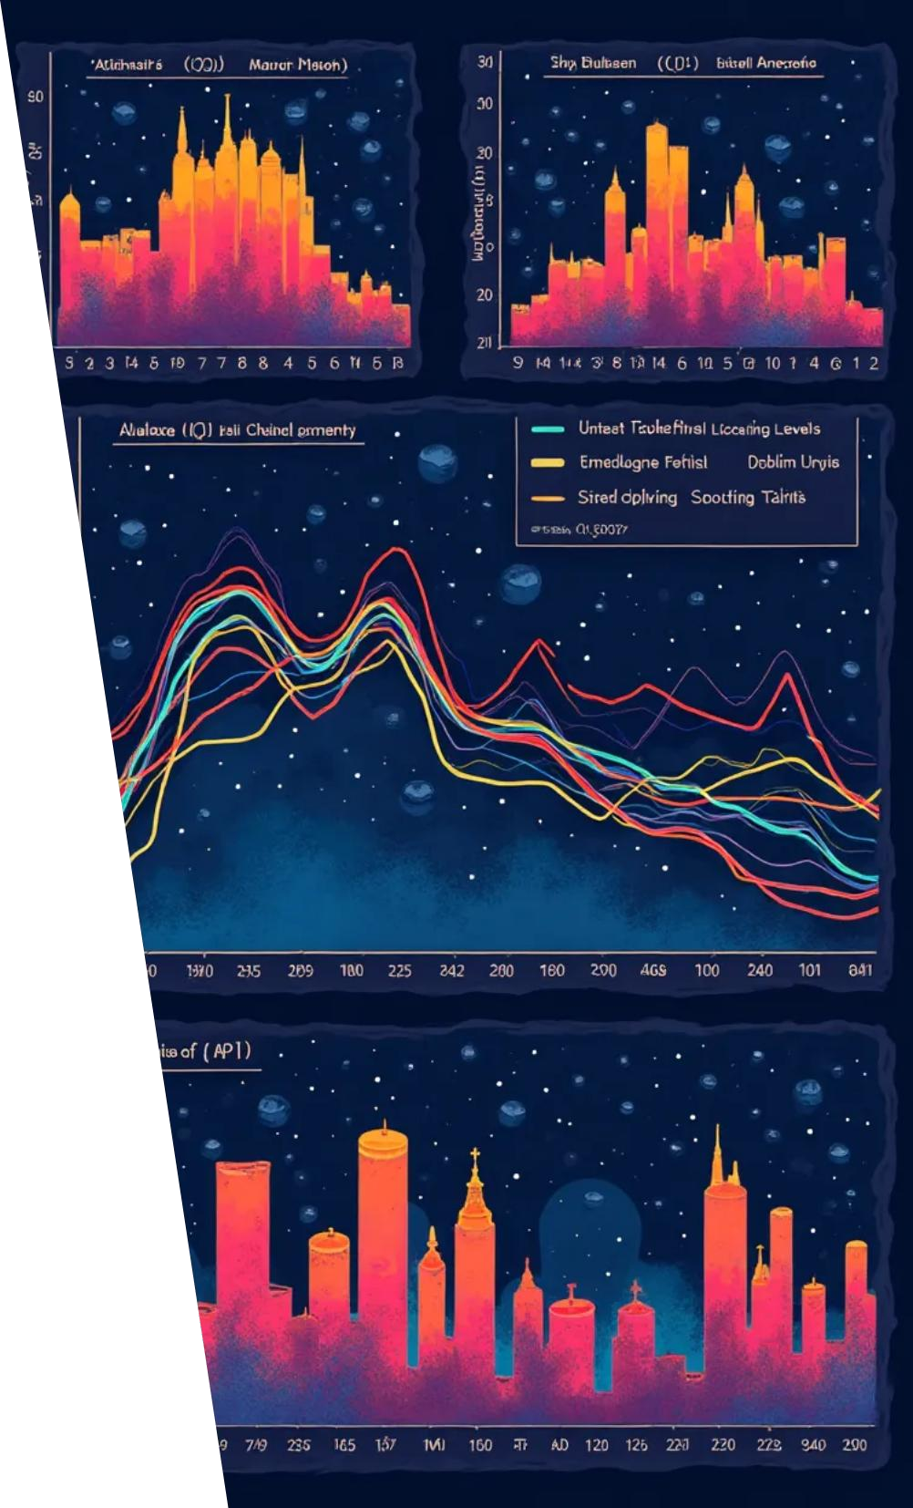
Understanding the Data
Visualizations
Created visualizations such as:
•Line plots depicting AQI trends over time.
•Heatmaps illustrating correlation between pollutants.
•Bar charts representing average AQI levels categorized by city.

Slide 16

06
Model Selection - Random forest Regression

Slide 17

Why ?
Feature Randomness
When a tree is split split at each node, a a random subset of of features is chosen chosen rather than than using all features. This helps helps ensure the trees are less correlated with each each other, which improves the model's generalization
Voting or Averaging
Ensemble of
Decision Trees
For classification, each tree votes for a class, and the majority vote is the final prediction.
A Random Forest is is made up of many many Decision Trees.
Trees. Each tree is trained on a random random subset of the data. This is called bagging (Bootstrap Aggregating). The idea is to reduce overfitting and increase accuracy
For regression, the final output is the average of all tree predictions.
.

Slide 18

07
Model Evaluation

Slide 19


Model Performance.
Metrics:
Mean Squared Error (MSE): e.g., 110.45
R² Score: e.g., 0.89 (means 89% of variance in AQI is explained by the model) model)
High R² indicates good model fit.

Slide 20
CODE:-

Slide 21

from google.colab import files
import zipfile import io
import pandas as pd
import matplotlib.pyplot as plt
import seaborn as sns
from sklearn.model_selection import train_test_split from sklearn.ensemble import RandomForestRegressor from sklearn.preprocessing import StandardScaler
from sklearn.metrics import mean_squared_error, r2_score # Step 1: Upload the ZIP file
print("Upload the ZIP file containing the AQI dataset...")
uploaded = files.upload()
# Step 2: Extract ZIP contents
for file_name in uploaded.keys():

Slide 22

Model Performance
Visualization
A predicted vs actual AQI scatter plot was created to visualize the model's performance.

Slide 23

08
Visualization of Results

Slide 24

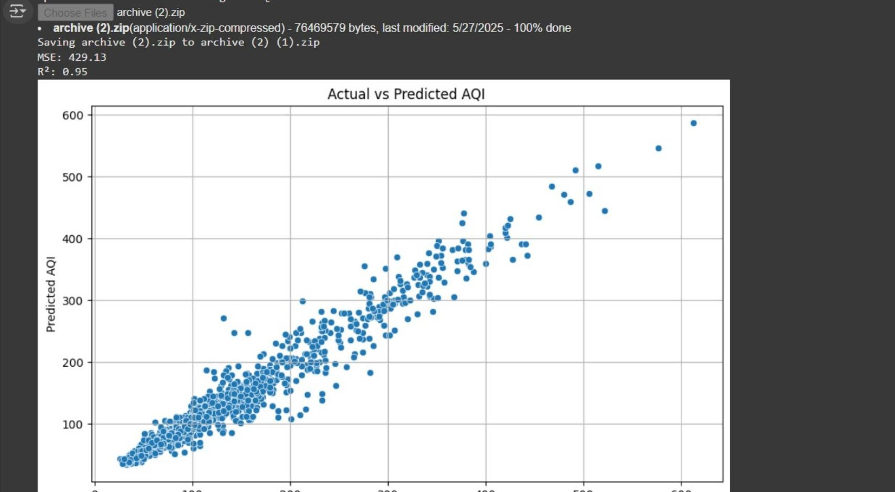

Slide 25

Regional AQI Visualization
1
Mapped AQI values across cities to identify regional pollution hotspots.
2
This helps in visualizing the distribution of air quality on a quality on a geographical scale.

Slide 26
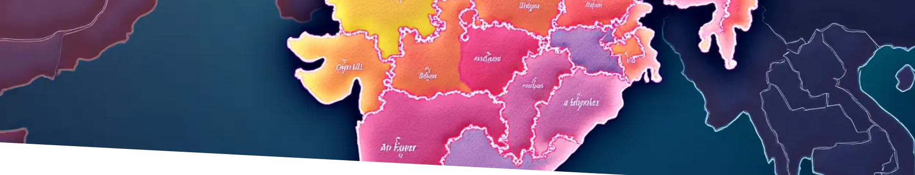
Regional AQI Visualization
Tools Used
•Utilized visualization libraries such as matplotlib, seaborn,
seaborn, or plotly.
Visualization Comparison
•Created a choropleth or bubble map of India highlighting
highlighting the AQI levels across various locations.

Slide 27

09
Challenges & Improvements

Slide 28

Limitations & Future Work
Addressed issues regarding data quality and missing value entries which can
which can skew results.
Noted city-wise imbalanced data that could affect model accuracy.
Suggested incorporating additional weather data to enhance model performance.
Future enhancements could include the use of deep learning techniques such techniques such as Long Short-Term Memory (LSTM) networks for time series time series forecasting.

Slide 29
Conclusion & Q/A
10

Slide 30
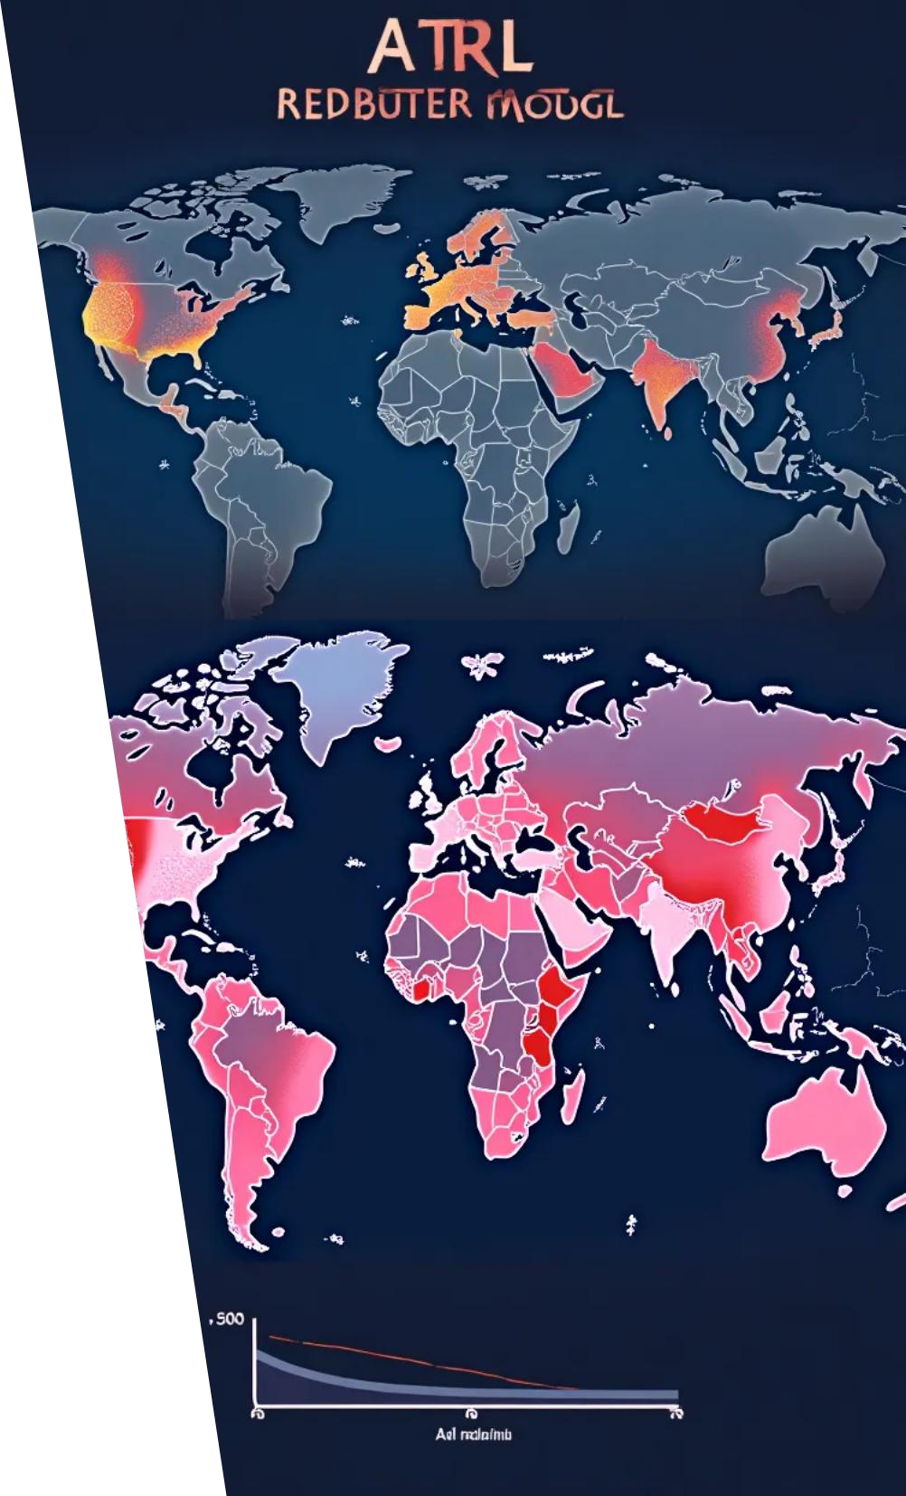
Conclusion
The Random Forest Regression (RFR) model effectively predicted AQI levels vs actual aqi level
Notably, pollution levels exhibit considerable variation across different
regions, which is critical for policy-making.
The predictive models developed can serve as valuable tools in guiding pollution control strategies and public health initiatives.

Slide 31

Thank You

